Slide 1
Garbage Management System
Clean&Green
Corse Code: CSCI317
Instructor: Dr. Mohammed El-Hajj
Done by: Ali Hamed 1220024

Slide 2
Introduction
Overview.
Problem.
Solution.

Slide 3
Structure of the article
The proposal.
Functional and Non-functional requirements.
Use case diagram.
Entity relationship diagram.
Data flow diagram.

Slide 4
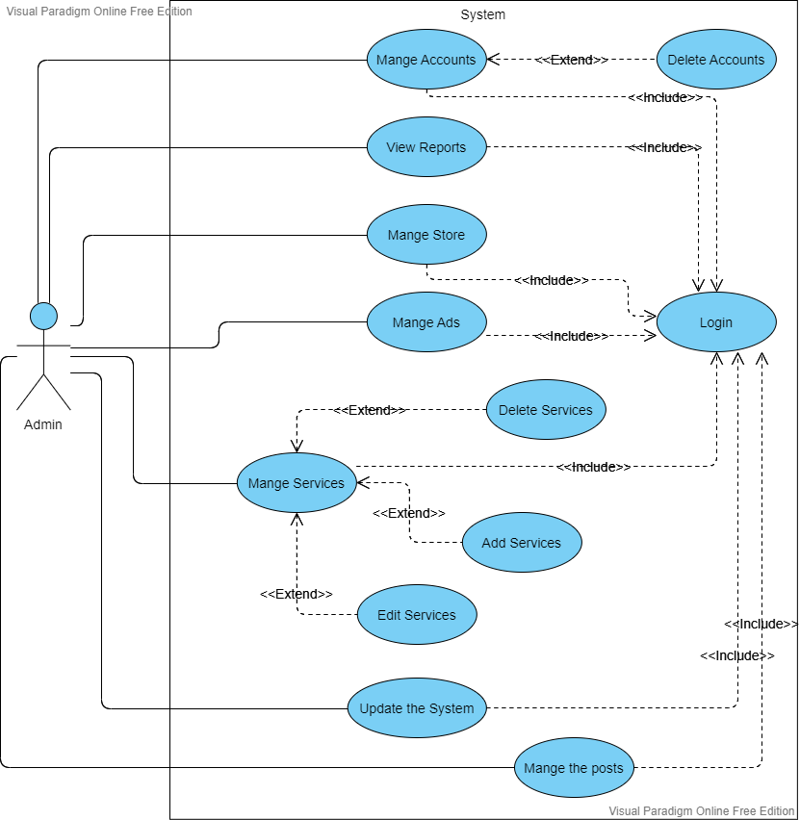
Use Case Diagram

Slide 5
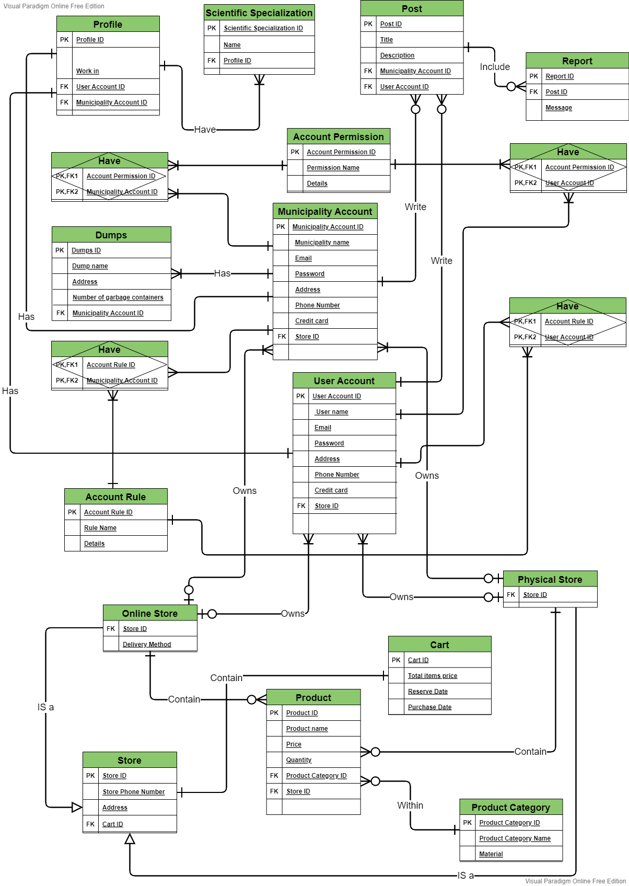
Entity relationship Diagram

Slide 6
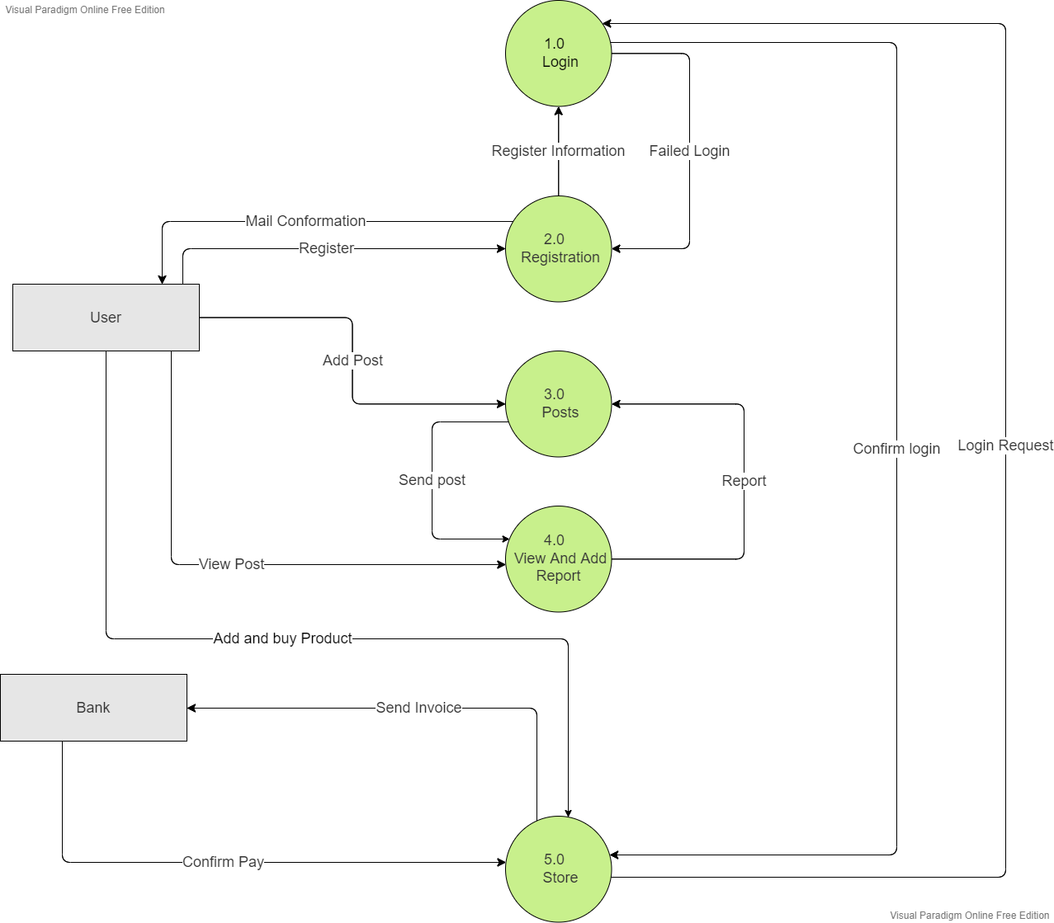
Data Flow Diagram

Slide 7
Gain of the course
Know the principles of writing.
Persuasion.
Organizing ideas.
Understand the project.
Optimize the project before implementation.
Find out how the effective the idea is.
Deliver the idea in a rich way.

Slide 8
Thank you

